Slide 1
Chapter 2
Simple Linear Regression
Linear Regression Analysis 5E Montgomery, Peck & Vining
1

Slide 2
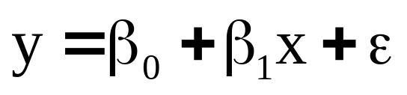
2.1 Simple Linear Regression Model
Single regressor, x; response, y
β₀ – intercept: if x = 0 is in the range, then β₀ is the mean of the distribution of the response y, when x = 0; if x = 0 is not in the range, then β₀ has no practical interpretation
β₁ – slope: change in the mean of the distribution of the response produced by a unit change in x
ε - random error
Population regression model
Linear Regression Analysis 5E Montgomery, Peck & Vining

Slide 3
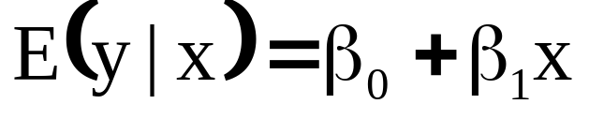
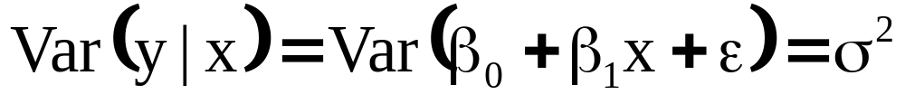
2.1 Simple Linear Regression Model
The response, y, is a random variable
There is a probability distribution for y at each value of x
  Mean:
  Variance:
Linear Regression Analysis 5E Montgomery, Peck & Vining

Slide 4
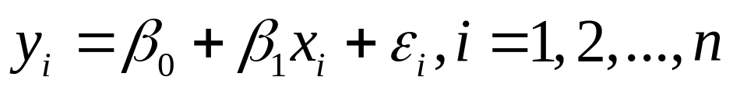
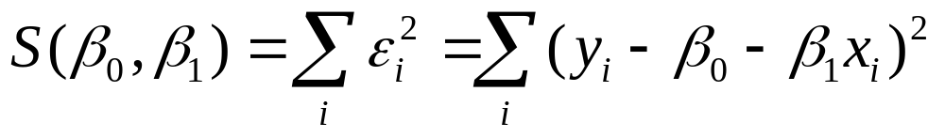
2.2 Least-Squares Estimation of the Parameters
β₀ and β₁ are unknown and must be estimated
Least squares estimation seeks to minimize the sum of squares of the differences between the observed response, y_{i}, and the straight line.
Sample regression model
Linear Regression Analysis 5E Montgomery, Peck & Vining

Slide 5
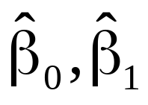
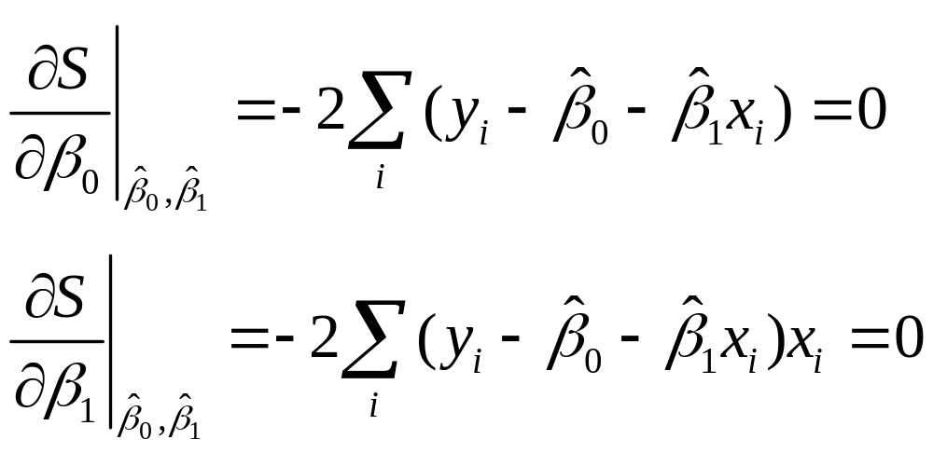
2.2 Least-Squares Estimation of the Parameters
Let represent the least squares estimators of β₀ and β₁, respectively.
These estimators must satisfy:
Linear Regression Analysis 5E Montgomery, Peck & Vining

Slide 6
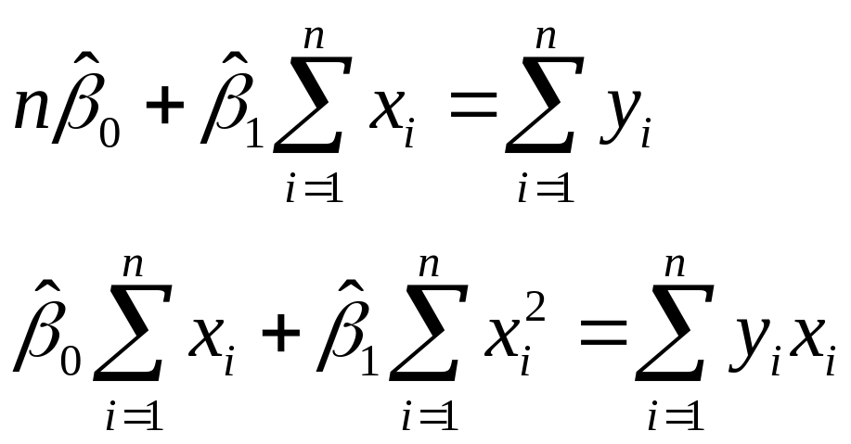
2.2 Least-Squares Estimation of the Parameters
Simplifying yields the least squares normal equations:
Linear Regression Analysis 5E Montgomery, Peck & Vining

Slide 7
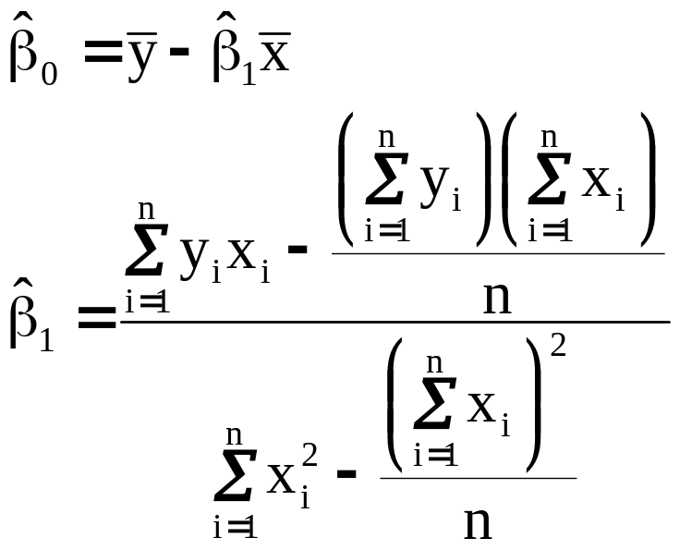
2.2 Least-Squares Estimation of the Parameters
Solving the normal equations yields the ordinary least squares estimators:
Linear Regression Analysis 5E Montgomery, Peck & Vining

Slide 8
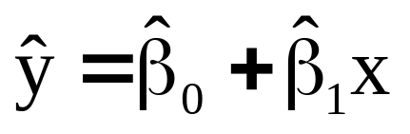
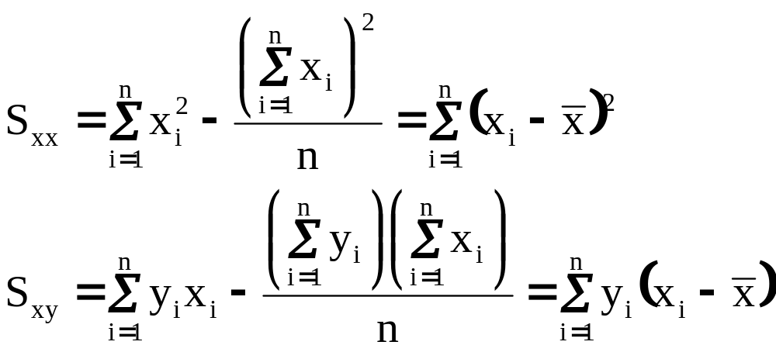
2.2 Least-Squares Estimation of the Parameters
The fitted simple linear regression model:
Sum of Squares Notation:
Linear Regression Analysis 5E Montgomery, Peck & Vining

Slide 9
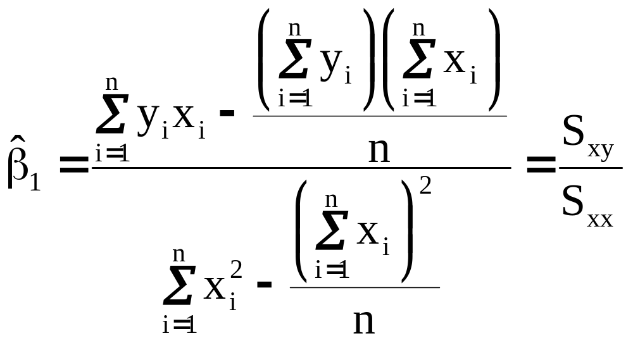
2.2 Least-Squares Estimation of the Parameters
Then
Linear Regression Analysis 5E Montgomery, Peck & Vining

Slide 10
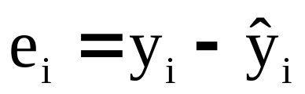
2.2 Least-Squares Estimation of the Parameters
Residuals:
Residuals will be used to determine the adequacy of the model
Residuals will be used to provide an estimator of σ² for use in inferences
residual= data - fit
Linear Regression Analysis 5E Montgomery, Peck & Vining

Slide 11
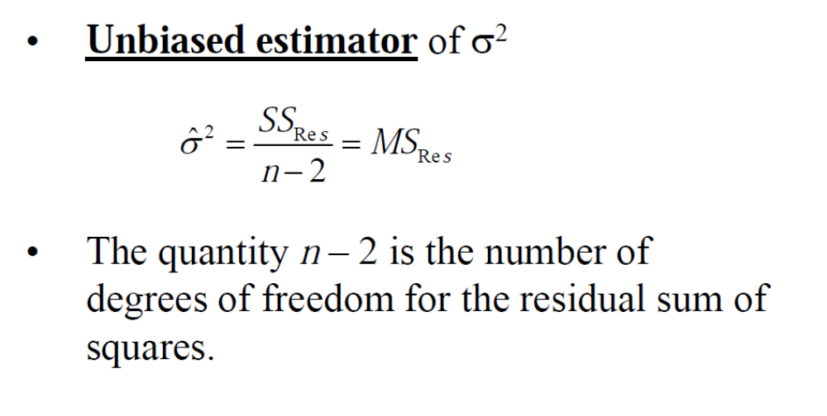
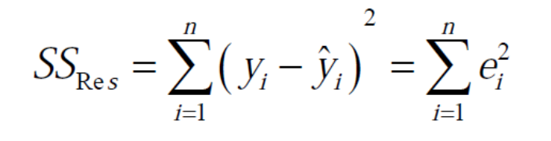
2.2 Least-Squares Estimation of the Parameters
Linear Regression Analysis 5E Montgomery, Peck & Vining

Slide 12
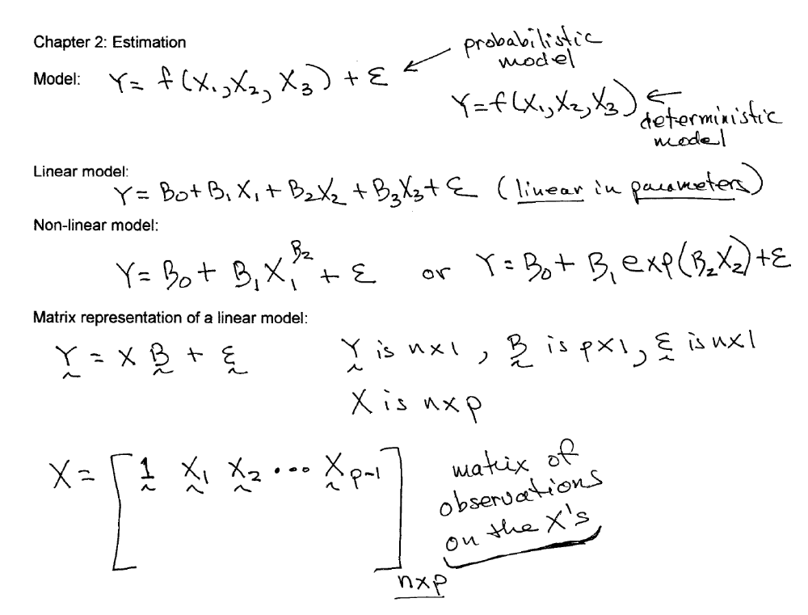
Multiple linear regression model

Slide 13

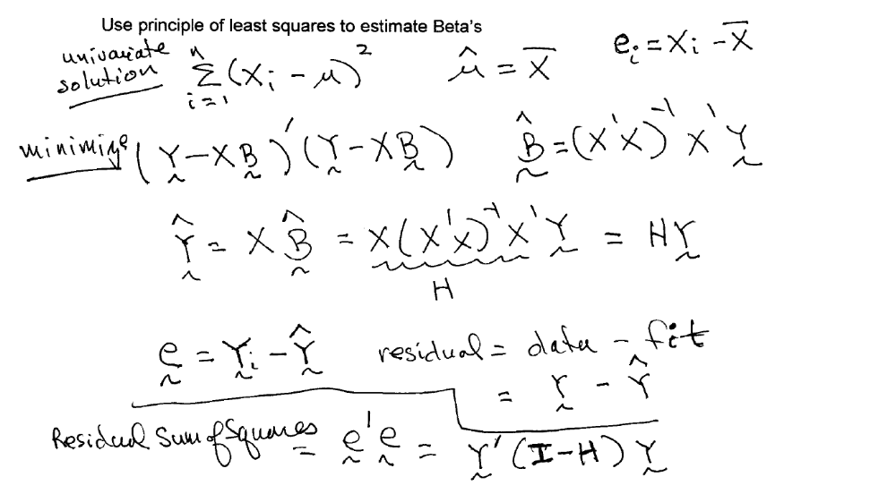
The matrix H is known as the “Hat” matrix

